Slide 1

Cross Selling Project
Virtual Internship: Final Presentation of Final Project
Group Name: Solo
Group Members: Abdullah GÖK (Turkey) Date: 18-June-2022

Slide 2
Data Glacier Internship Final Project
Problem Description & Objection
Customers General Analysis
XYZ Bank cross selling analysis
Exploratory Data Analysis
EDA Recommendations

Slide 3

Background – Drug Persistency case study
Problem description
General Overview
XYZ Credit Union in Latin America is performing very well in selling the Banking products (eg: Credit card, deposit account, retirement account, safe deposit box etc) but their existing customer is not buying more than 1 product which means bank is not performing good in cross selling (Bank is not able to sell their other offerings to existing customer). XYZ Credit Union decided to approach ABC Analytics to solve their problem.
Problem
XYZ Credit Union is performing very well in selling the Banking products but is not performing good in cross selling.
Objective
Find important features of customers , investigate them for solving the issue and visualize the findings.
The analysis has been divided into several parts:
Data Understanding
Data Cleaning
Data insights,EDA and Visualization
Recommendations

Slide 4
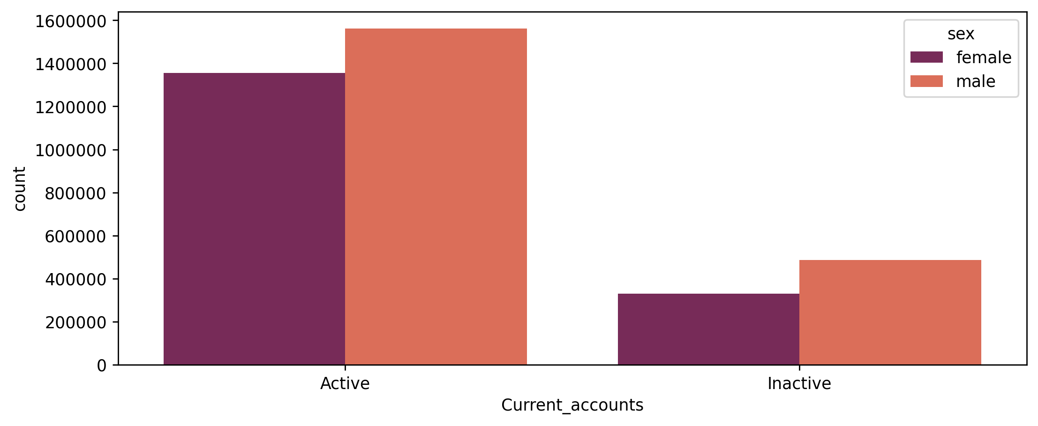
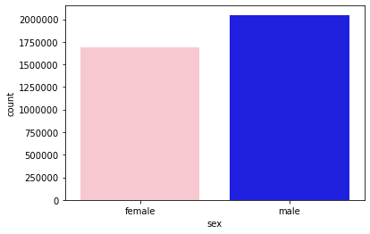
Profit Analysis
Customers General Analysis
- Gender Analysis
Distribution of Bank’s customers by Gender
Current Accounts vs Gender

Slide 5
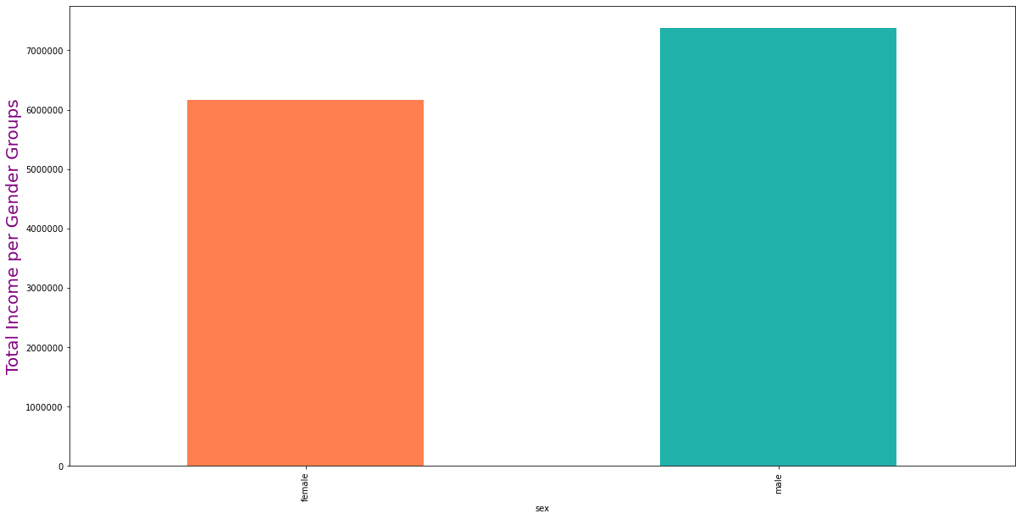
Profit Analysis
Customers General Analysis
- Gender Analysis
FEMALE
MALE
SEX
Total Income per Gender

Slide 6
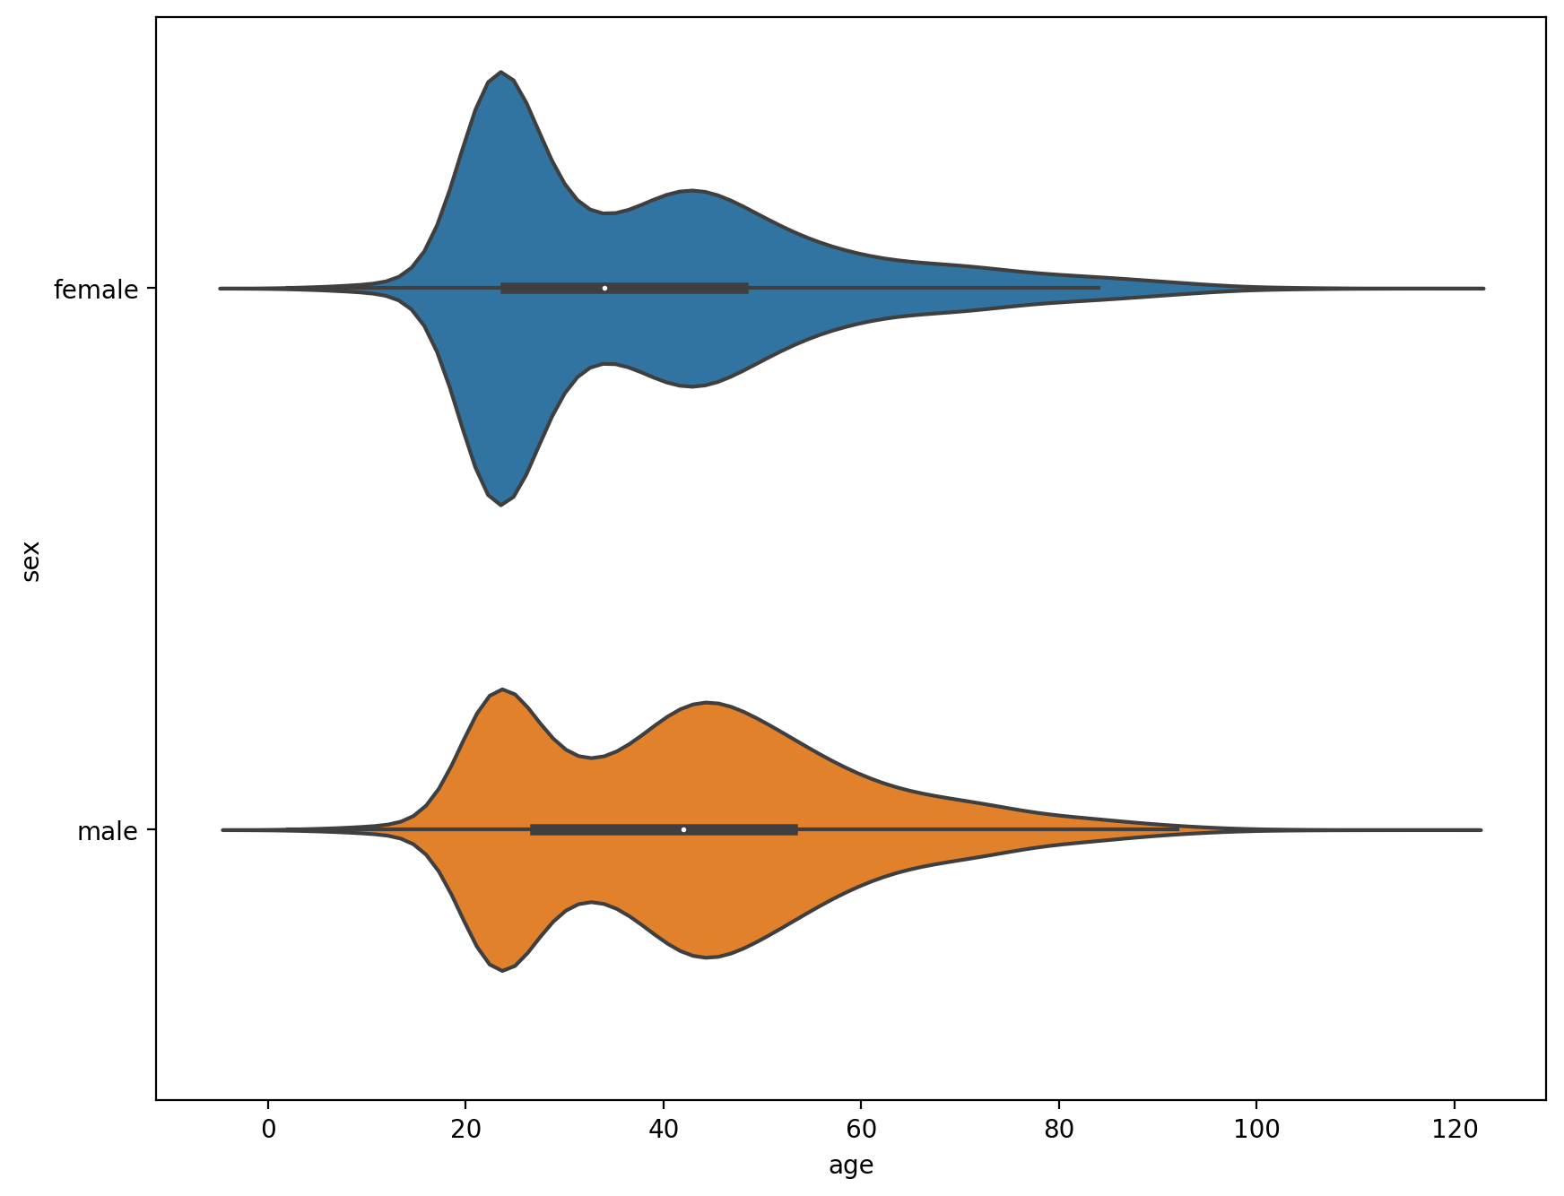
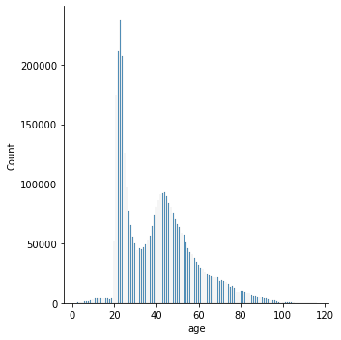
Profit Analysis
Customers General Analysis
- Age Analysis
Distribution of Bank’s customers by age
Gender Density by Age

Slide 7
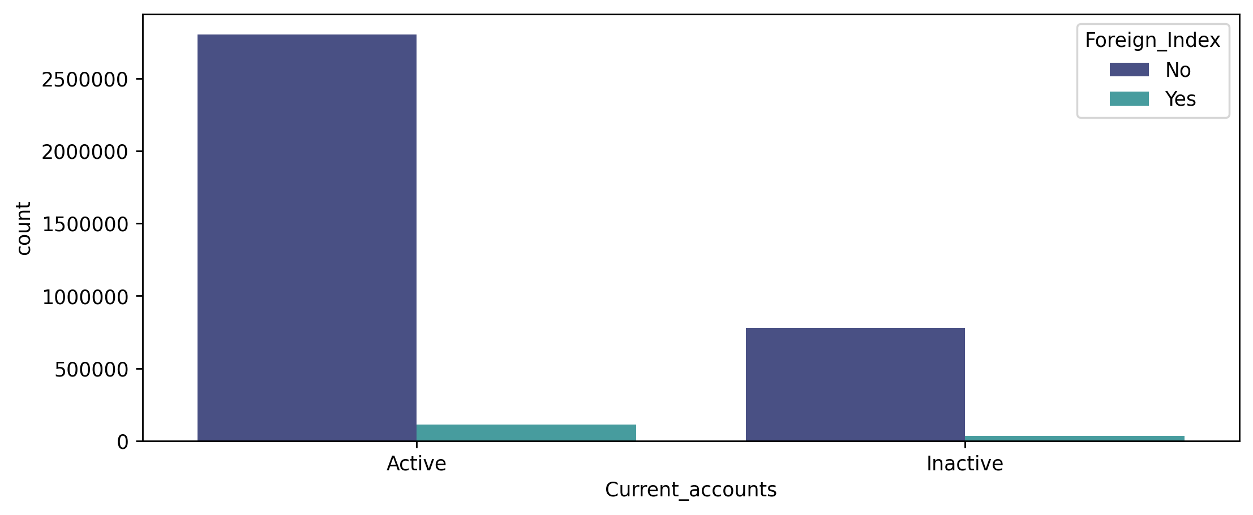
Profit Analysis
Customers General Analysis
- Current Accounts Analysis
Current Accounts vs. Foreign Index
Current Accounts vs Gender

Slide 8
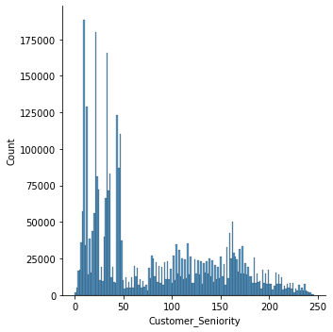
Profit Analysis
Customers General Analysis
- Seniority Analysis
Customer Seniority Distribution

Slide 9
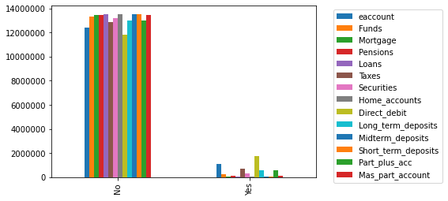
Profit Analysis
Exploratory Data Analysis-Cross Sales
- Product Analysis
Top 3 Cross Saled Products:
Direct Debit
eaccount
Mortgage
Cross selling products current overview

Slide 10
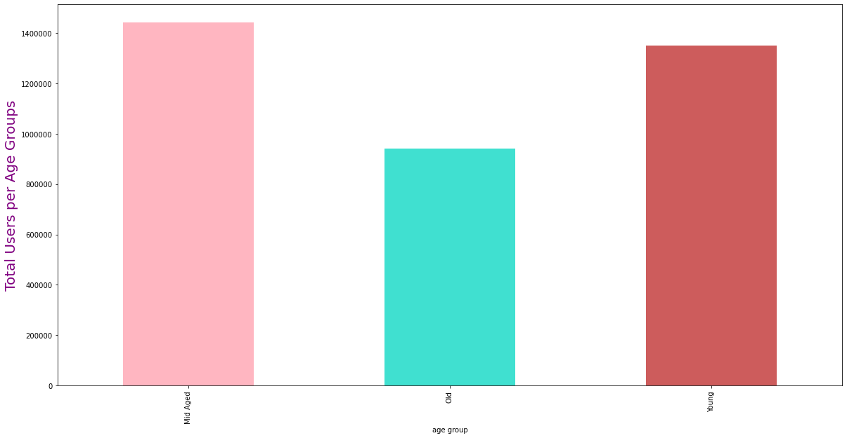
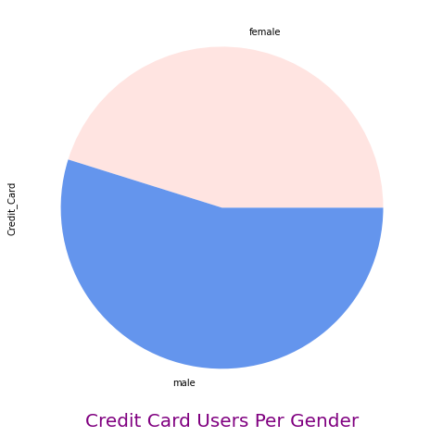
Profit Analysis
Exploratory Data Analysis-Cross Sales
- Product Analysis in Detail: Credit Card
FEMALE
CREDIT CARD
MALE
Mid-Age
Old
Young
Age Groups
Credit Card vs Gender
Credit Card vs Age Groups

Slide 11
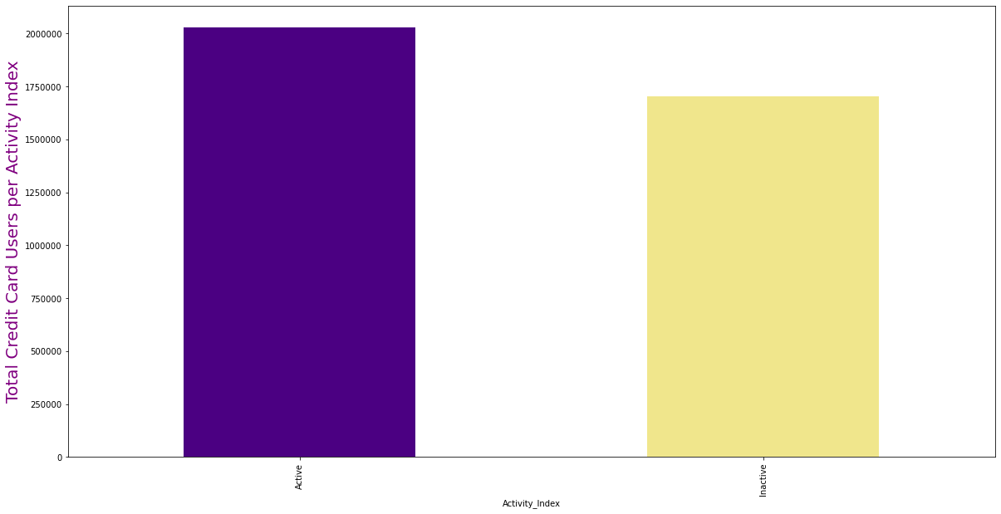
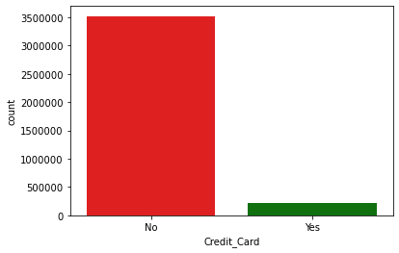
Profit Analysis
Exploratory Data Analysis-Cross Sales
- Product Analysis in Detail: Credit Card
Active
Activity Index
Inactive
Activity Index of Credit Card Users
Total Credit Card Users

Slide 12
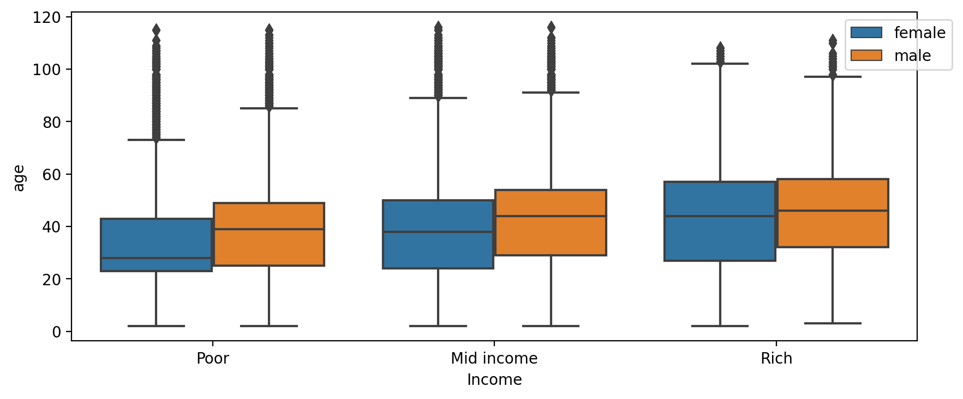
Profit Analysis
Exploratory Data Analysis-Cross Sales
- Product Analysis in Detail: Credit Card
Total Card users vs gender and age

Slide 13
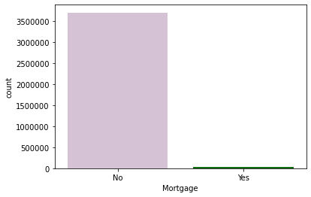
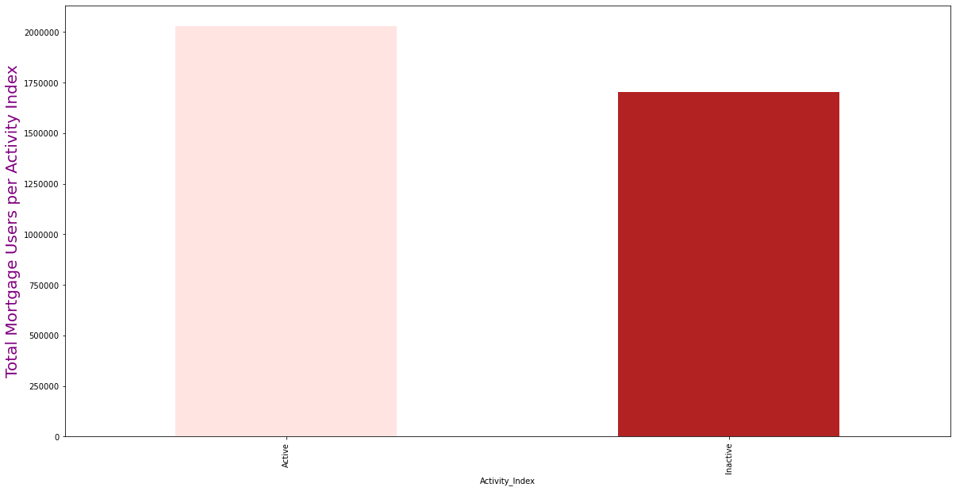
Profit Analysis
Exploratory Data Analysis-Cross Sales
- Product Analysis in Detail: Mortgage
Active
Inactive
Activity Index
Total Mortgage Users
Activity Index of Mortgage Users

Slide 14
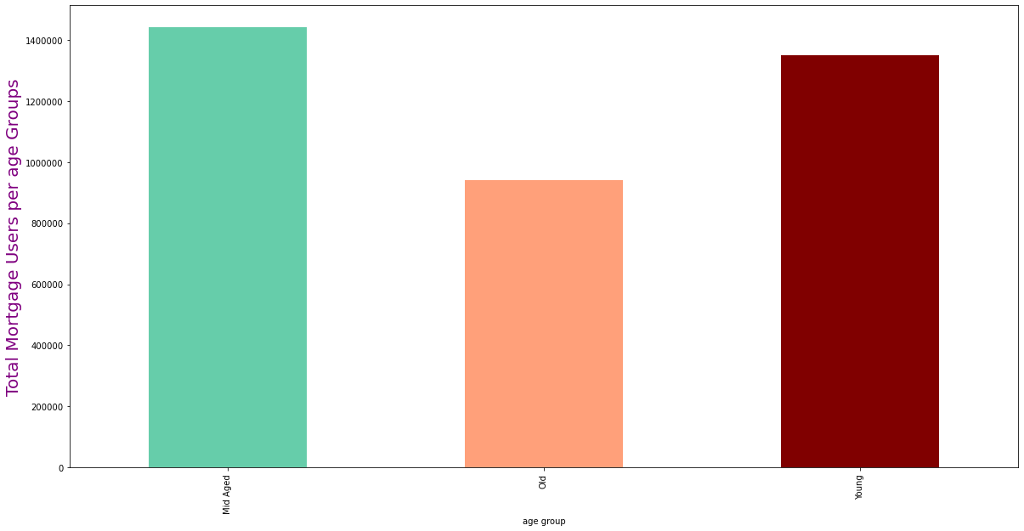
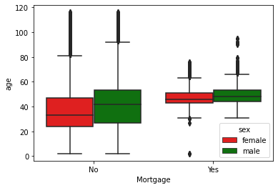
Exploratory Data Analysis-Cross Sales
- Product Analysis in Detail: Mortgage
Mid-Age
Old
Young
Age Groups
Age Group Distribution of Mortgage users
Gender and Age Distribution of Mortgage users

Slide 15
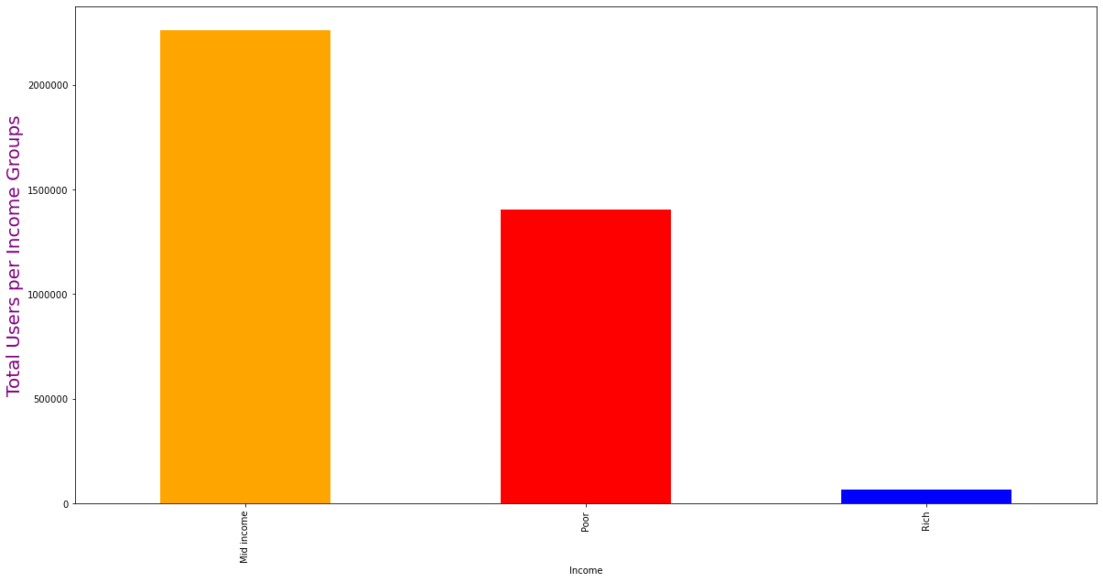
Exploratory Data Analysis-Cross Sales
- Product Analysis in Detail: Mortgage
Mid-Income
Poor
Rich
Income
Wealth Distribution Mortgage users

Slide 16
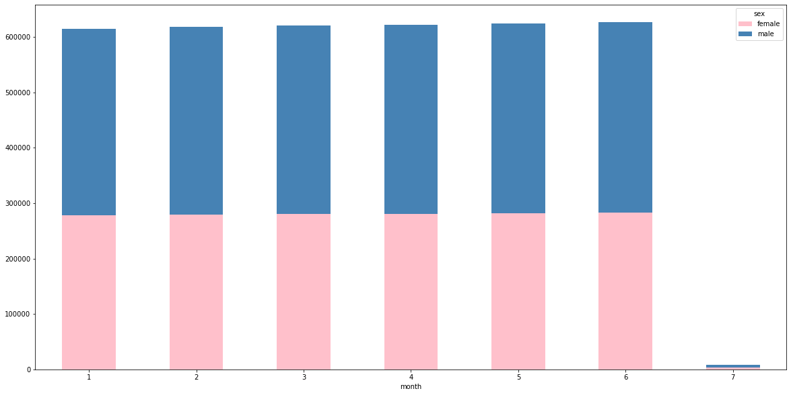
Exploratory Data Analysis-Cross Sales
- Product Analysis in Detail: Taxes
Month
Monthly numbers of Tax Payment via XYZ Bank per gender

Slide 17
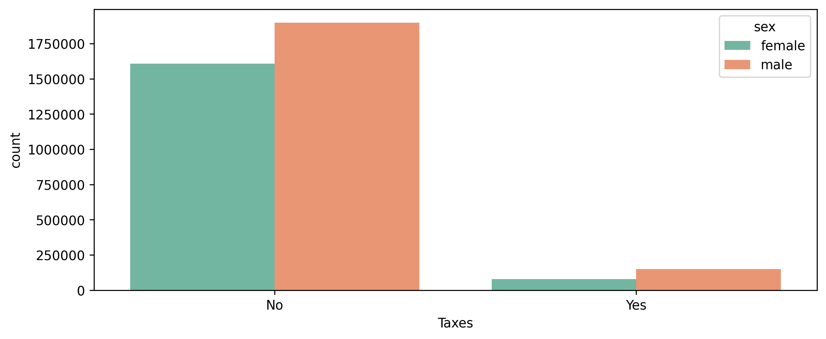
Exploratory Data Analysis-Cross Sales
- Product Analysis in Detail: Taxes
Tax Distribution by Gender

Slide 18
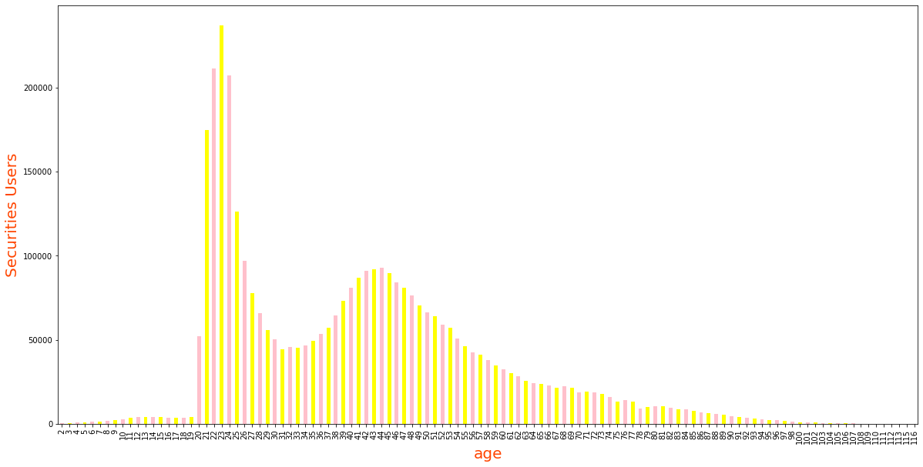
Exploratory Data Analysis-Cross Sales
- Product Analysis in Detail: Securities
Number of non-persistency is higher in lower counts of risks.
Patients with zero count of risk have the highest Non-Persistent Ration
Low risk patients were found to be less persistent than the high-risk ones.
Age Distribution of Securities Users

Slide 19
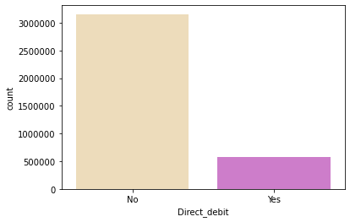
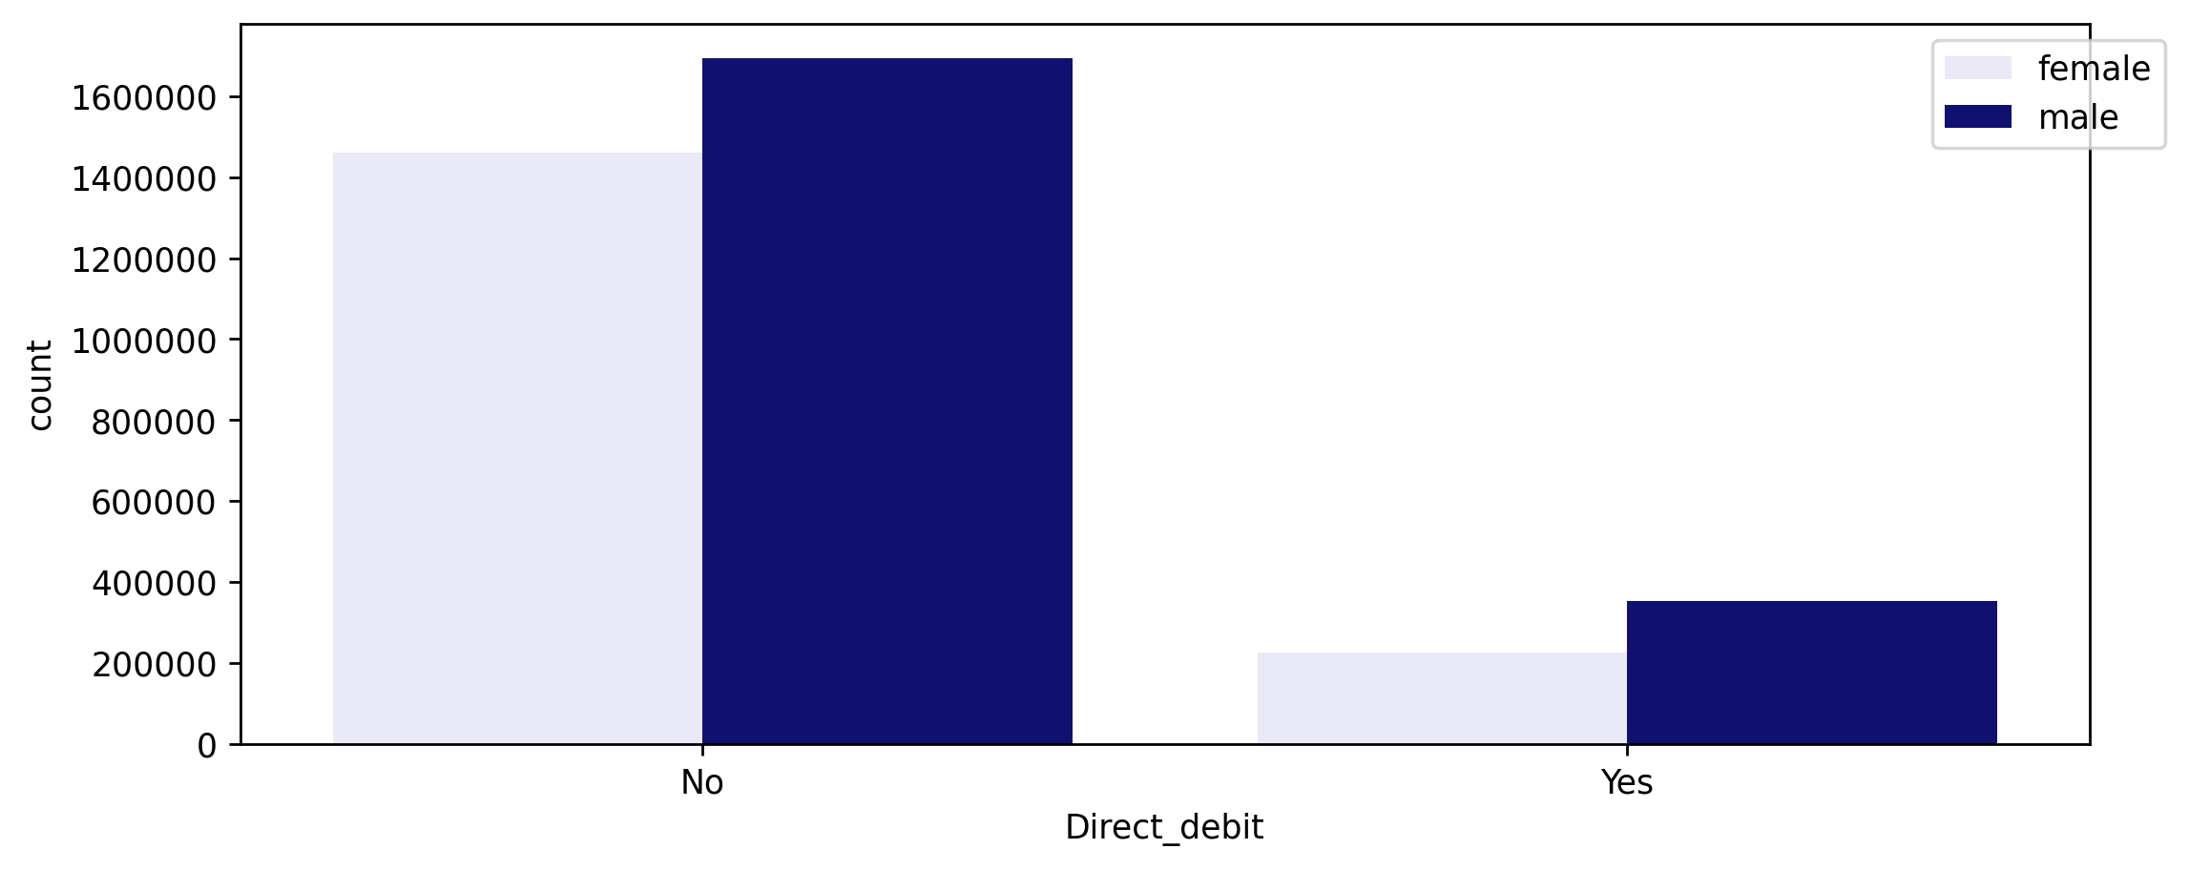
Exploratory Data Analysis-Cross Sales
- Product Analysis in Detail: Direct Debit
Direct Debit Distribution
Direct Debit Distribution by Gender

Slide 20
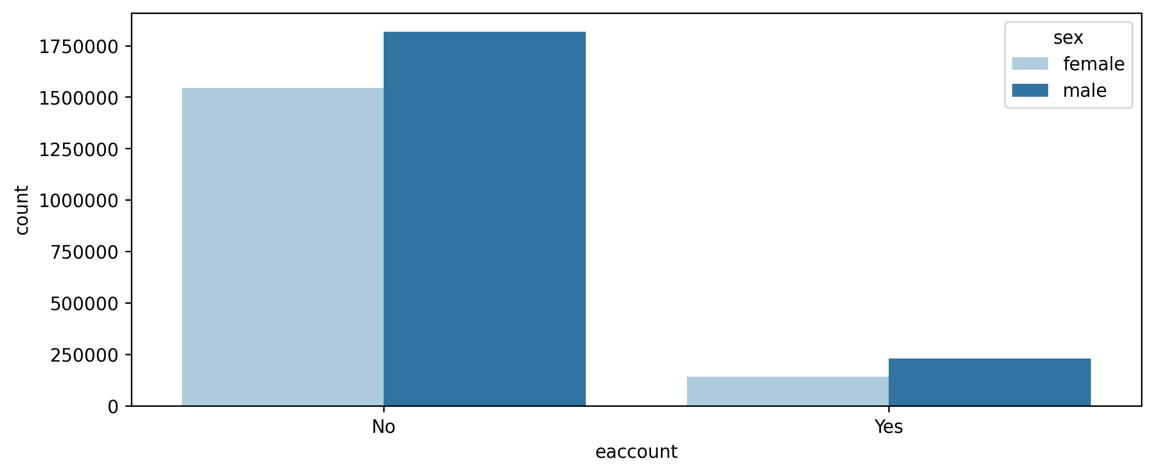
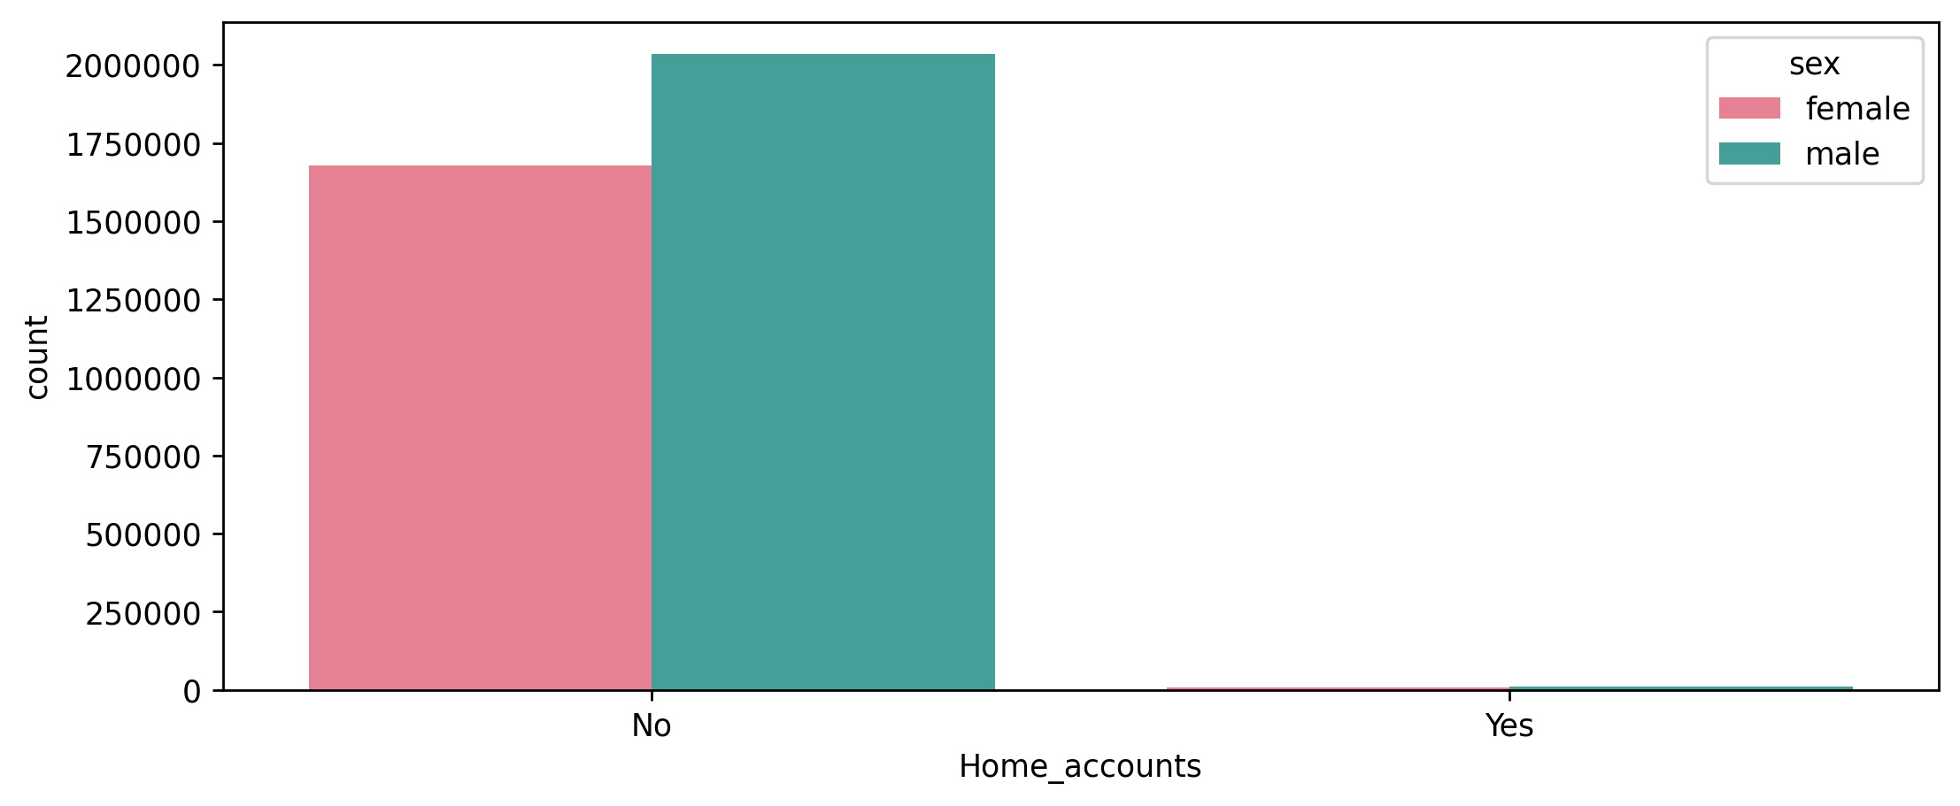
Exploratory Data Analysis-Cross Sales
- Product Analysis in Detail: eaccount & Home Account
eaccount Distribution by Gender
Home Account by Gender

Slide 21
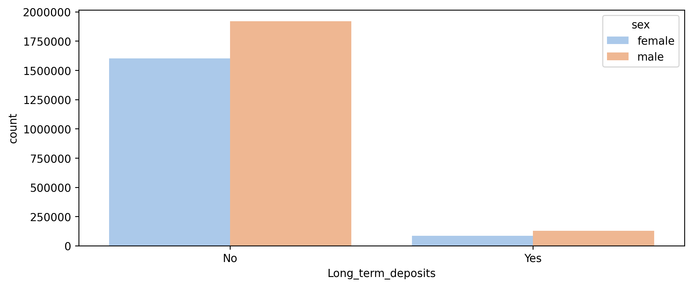
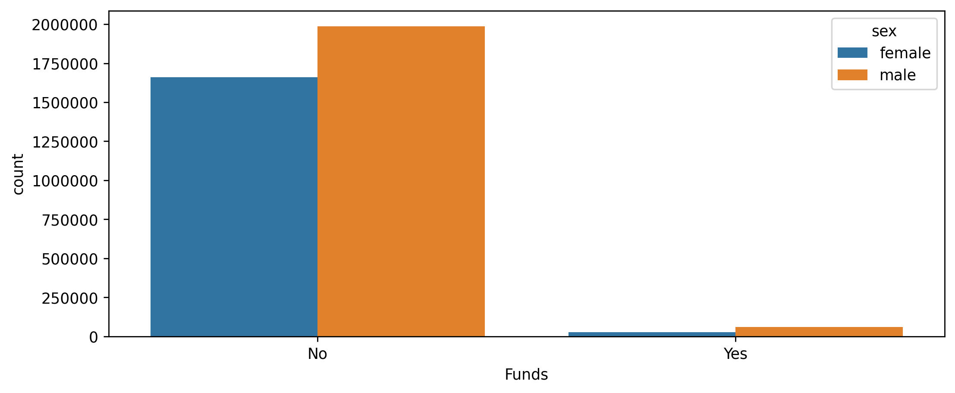
Exploratory Data Analysis-Cross Sales
- Product Analysis in Detail: Long Term Deposits & Funds
Long Term Deposits Distribution by Gender
Funds Distribution by Gender

Slide 22
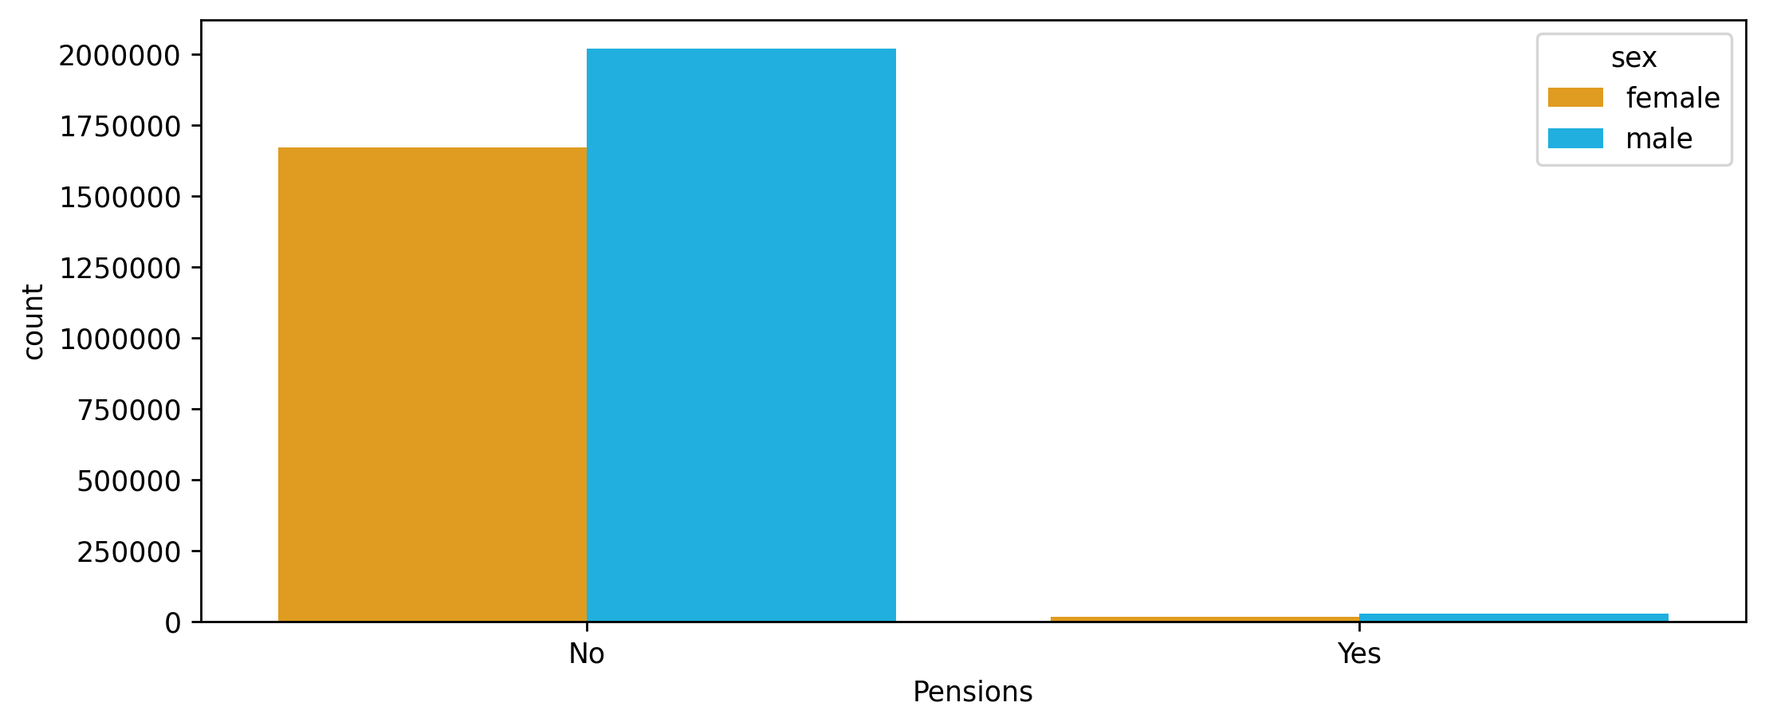
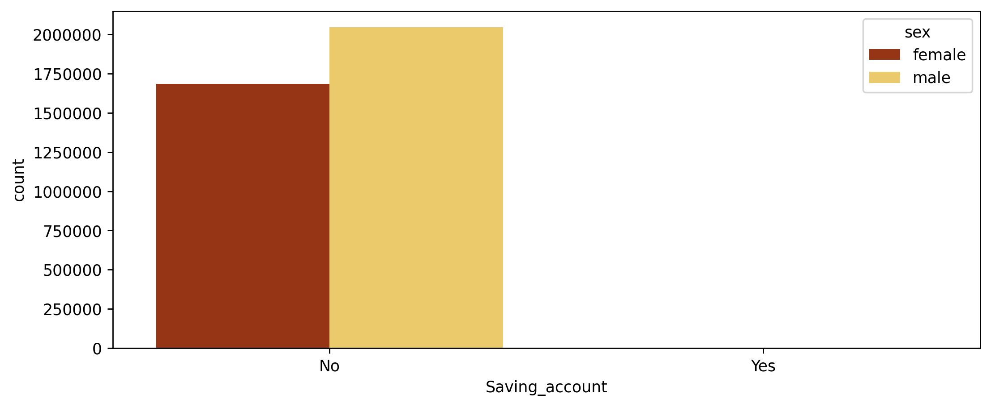
Exploratory Data Analysis-Cross Sales
- Product Analysis in Detail: Pensions & Saving Accounts
Pensions Distribution by Gender
Saving Accounts Distribution by Gender

Slide 23

EDA Recommendations-1
FINDINGS,SUMMARY AND SOLUTION OFFERS:
As we all plotted cross product sellings and related parameters of XYZ Bank we can offer them to take into consideration these above to increase cross sellings:
1) Bank has dominantly young and mid aged customers who should be aimed to make buying cross products in advertisements or campaigns
2)Mid Income and Poor Income customers are more than rich customers which is a remarkable note to mention
3)Male and Female users has likely similar total Gross Incomes
4)Bank has a vast majority of "Local Customers" comparing to foreign customers

Slide 24
EDA Recommendations-2
FINDINGS,SUMMARY AND SOLUTION OFFERS:
5)Male customers has slightly more interested in cross products than females
6)3 most popular cross selled products are direct debit, eaccount and mortgage which leads us to think perhaps Bank should
invest more in digital banking to increase those sales.
7)Credit Card users have high amount of Inactive account index which makes us to think that many customers are choosing the bank only for credit card maybe combo campaigns of cross products with credit card may increase those sales.
8)Similar to Credit Card users , Mortgage users has high percentage of Inactive accounts and like in credit card topic combo campaigns including Mortgage may be beneficial.

Slide 25


